Slide 1

“Protect Me When I’m Vulnerable”
INITIAL DESIGN
Debasis Kar, Deepak Kumar, Abhilash Mishra

Slide 2
Basic Android UX/UI Guidelines
Real objects are more fun.
Keep it short and simple. (KISS)
Pictures are faster than words.
Only interrupt me if it's important.
Never lose my stuff.
If it looks the same, it should act the same.s
Only show what I need when I need it.
Get to know me.

Slide 3
Prototyping
Prototype is a working model of software with limited functionality.
The prototype does not always hold the exact logic.
Prototyping is used to allow the users evaluate developer proposals.
Initial Prototype is developed in this stage, where the very basic requirements are showcased and user interfaces are provided.
These features may not exactly work in the same manner internally in the actual software developed and the workarounds are used to give the same look and feel to the customer in the prototype developed.

Slide 4
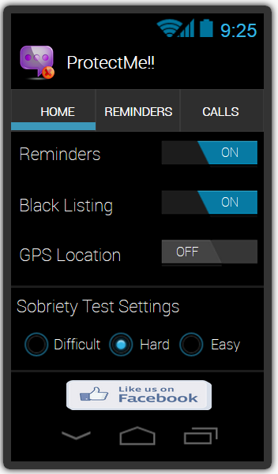
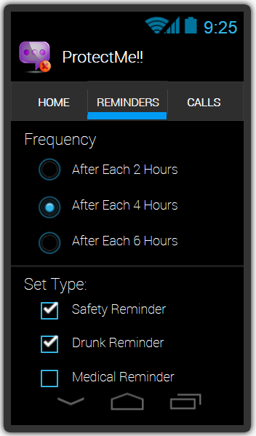
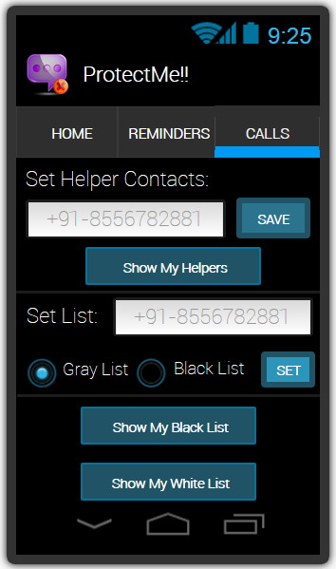
Initial Design of UI

Slide 5
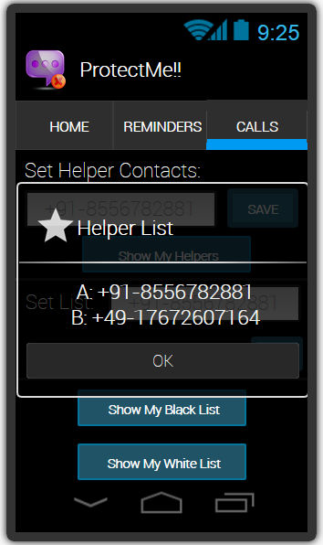
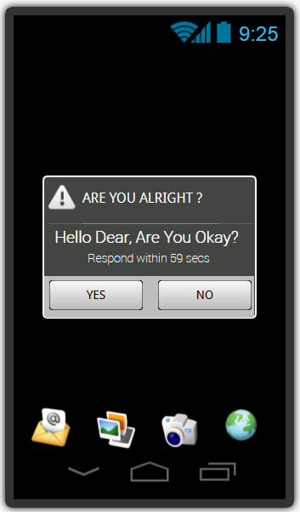
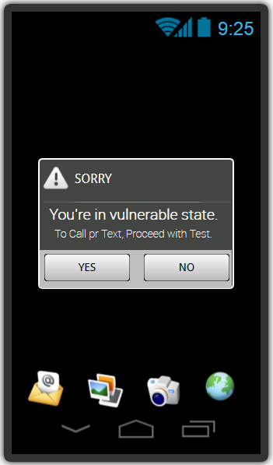
Initial Design of UI Contd..

Slide 6
Sample Interactive Flow

Slide 7

THANK YOU!!!

